Slide 1
Neural Networks Basics
Jen-Ing Hwang
Department of Computer Science and
Information Engineering
Fu Jen Catholic University

Slide 2
Outline
Brief History of Neural Networks
Biological Inspiration
Artificial Neuron
Illustrative Example: Neural Representation
Activation Functions
Network Architectures
A Layer of Neurons
Multiple Layers of Neurons

Slide 3
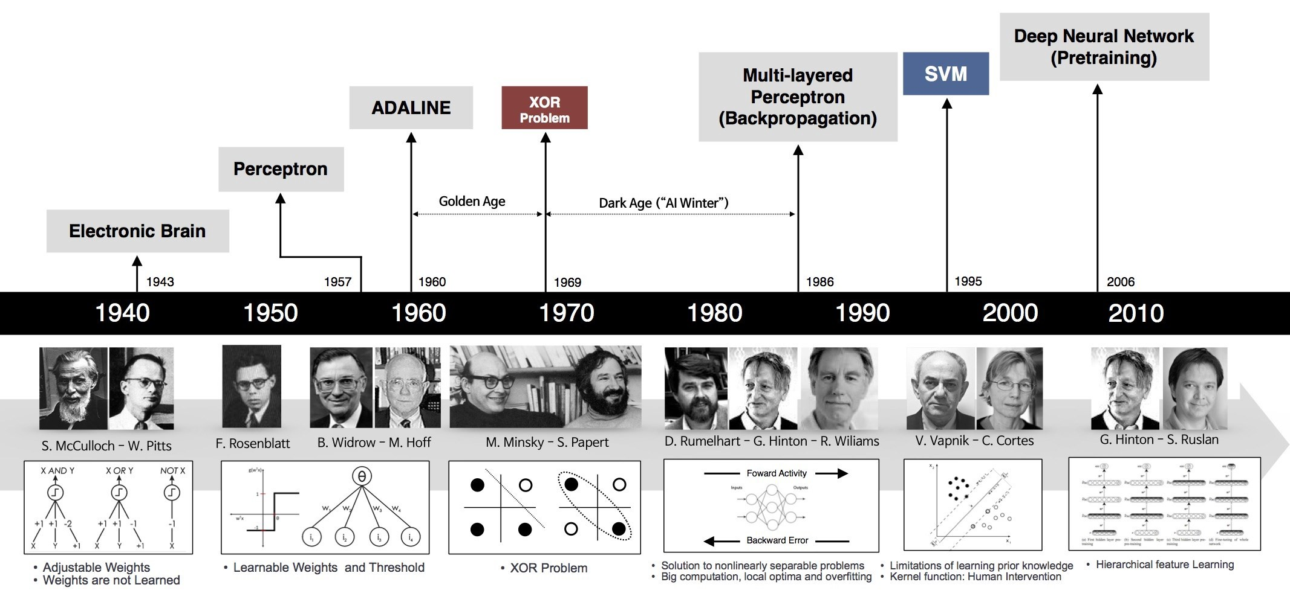
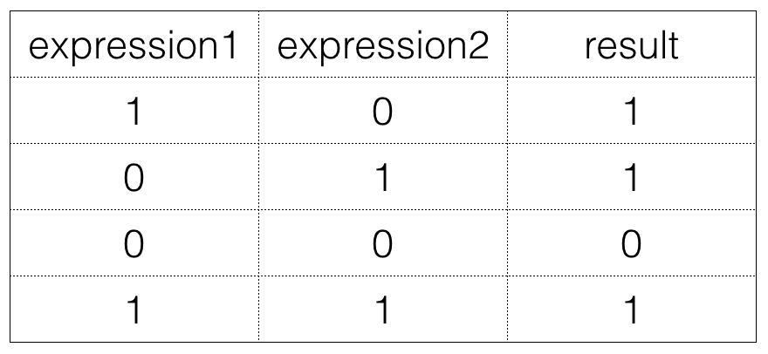
Brief History of Neural Networks (1/4)
Deep learning崛起的因素： 1. (硬體) GPU
2. (軟體) 演算法、軟體工具
3. (Data) 資料量多
用人工自己去調權重
不是學習而來的
Ex:考兩科，其中一科一百分就有獎勵，考兩科更好，白色的代表沒有一百分

Slide 4
Brief History of Neural Networks (2/4)
1943: McCulloch & Pitts
Show that neurons can be combined to construct a Turing machine
1958: Rosenblatt
Shows that perceptron will converge if what they are trying to learn can be represented
1950s: Rosenblatt, Widrow & Hoff
First practical networks and learning rules
The Widrow-Hoff learning rule is still in use today
1969: Minsky & Papert
Show the limitations of perceptron, killing research in neural networks for a decade

Slide 5
Brief History of Neural Networks (3/4)
1980s: Rumelhart, Hinton & Williams
The backpropagation algorithm revitalizes the field
1998: Yan LeCun
Convolutional Neural Networks with Backpropagation for document analysis
2006: The Hinton lab solves the training problem for Deep Neural Networks
2012 - present:
A variety of deep learning algorithms are increasingly emerging

Slide 6
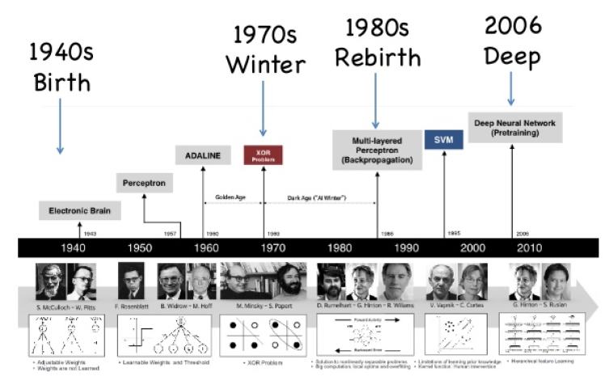
Brief History of Neural Networks (4/4)

Slide 7
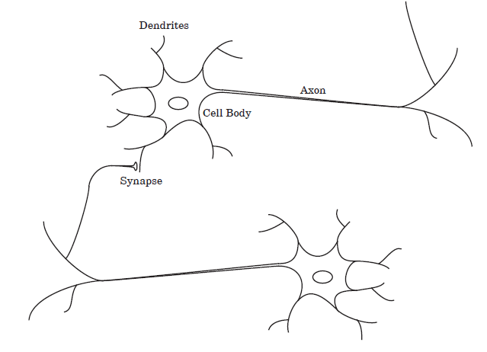
Biological Inspiration (1/3)
樹突
Biological motivation
Biological learning system (brain)
Complex network of neurons
軸突
細胞體
突觸
Figure adapted from Fig 1.1 in Ref. [2]

Slide 8
Biological Inspiration (2/3)
A neuron consists of a cell body (細胞體)(中心體) , dendrites (樹突)(輸入) and an axon (軸突)(輸出).
Neurons are massively interconnected, where an interconnection is between the axon of one neuron and a dendrite of another neuron.
This connection is referred to as a synapse (突觸)->用來決定每個輸入值的重要程度

Slide 9
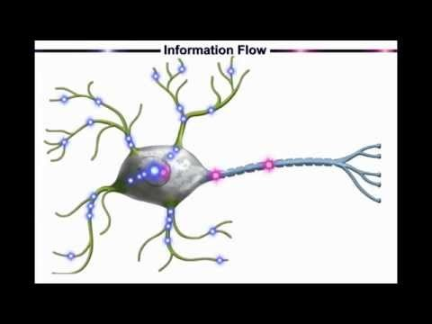
Biological Inspiration (3/3)
Neural Networks: A Simple Explanation
https://youtu.be/gcK_5x2KsLA

Slide 10
Artificial Neuron (1/2)
An artificial neuron is a model of a biological neuron.
Based on model of brain
Network of simple units
Real-valued inputs & outputs
Bias：偏差值
X0恆為1
W0：用來移動直線
ex:讓線不通過原點
x₀ ≡ 1
x₁
Bias: w₀
Cell body
w₁
Input signals: x_{i}
x₂
w₂
Output signal: a = f(n)
n
f(n)
w_{M}
x_{M}
Net input: n = w₀ x₀ + w₁x₁ + … + w_{M}x_{M}
Weights: w_{i}
Activation Function: f(n)

Slide 11
Artificial Neuron (2/2)
Bias and Weight
The bias b is much like a weight w, except that it has a constant input of 1. It can be omitted for some situation.
The bias b (= w₀) and weights w_{i}, I = 1, 2,…, M, are adjustable可調整的 scalar parameters of the neuron. They can be adjusted by some learning algorithm so that the neuron input/output relationship meets some particular goal.

Slide 12
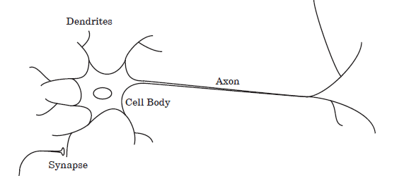
Biological Neuron Vs. Artificial Neuron
Biological Neuron
Artificial Neuron
x₀ ≡ 1
x₁
Bias: w₀
Cell body
w₁
Input signals: x_{i}
x₂
w₂
Output signal: a = f(n)
n
f(n)
w_{M}
x_{M}
Weights: w_{i}
Net input: n = w₀ x₀ + w₁ x₁ +…+ w_{M} x_{M}
Dendrites (樹突)
Input signals (x_{i})
Synapses (突觸)
Weights (w_{i})
Cell Body (細胞體)
Cell Body (n, f(n))
Axon (軸突)
Output signal (a)

Slide 13
Illustrative Example for Linear Classification
Dataset D
− Students take a class on a Pass/Fail basis
Students | x₁ (Midterm) | x₂ (Final) | y (Pass/Fail)
A | 80 | 60 | +1 (Pass)
B | 50 | 50 | −1 (Fail)
C | 90 | 80 | +1 (Pass)
D | 30 | 60 | −1 (Fail)
E | 40 | 90 | +1 (Pass)
F | 90 | 50 | +1 (Pass)

Slide 14
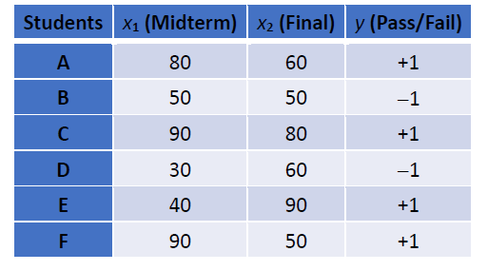
Illustrative Example: Neural Representation
Students' Performance Dataset
Synapses突觸
1
w₀
Axon軸突
x₁
n
f(n)
a
w₁
x₂
w₂
Cell body
Dendrites樹突
f (x_{1,} x₂ ) = sign ((w₁ x₁ + w₂ x₂) − threshold)
= sign (w₀ x₀ + w₁ x₁ + w₂ x₂ )
Ex:
0.4 X1 + 0.6 X2 > 50 及格
則0.4 = W1, 0.6 = W2
− threshold(門檻值)
1

Slide 15
Activation Functions (1/3) ( = transfer function)
Activation function f(n):
Define the output of a node when given the inputs of the node
The output of a neuron can either inhibit (抑制、不觸發) or excite (激發、觸發) the net input n
Ex: 及格 -> 觸發
不及格 -> 不觸發

Slide 16
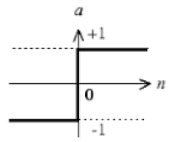
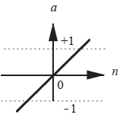
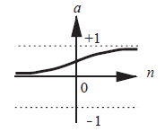
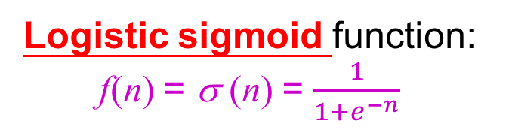
Activation Functions (2/3)
函式考試必考!!
一個東西有很多名稱，表示它很重要，表示有個領域的人來做研究，並用不同的名稱來稱呼它
The activation function f may be a linear or nonlinear function of n
Logistic sigmoid function: f(n) = σ (n) = $\frac{1}{1+e^{−n}}$
Sign function:
f(n) = sign (n)
Linear function: f(n) = n
0.4 X1 + 0.6 X2 = 0
Ex: 老師完全不調分，也沒有門檻值
n = 0 -> σ (n) = ½
n = ∞ ->σ (n) = 1

Slide 17
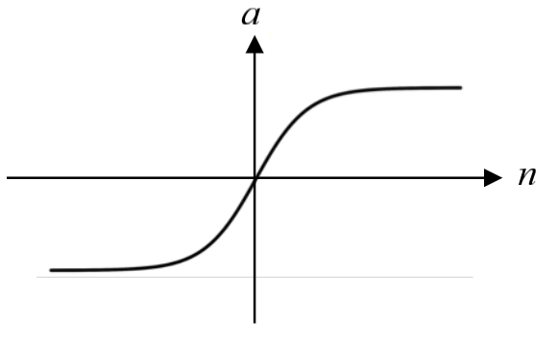
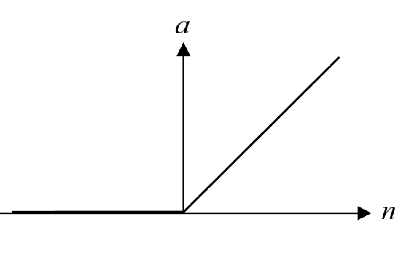
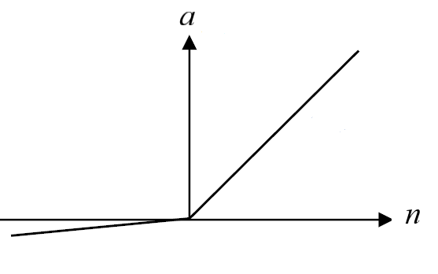
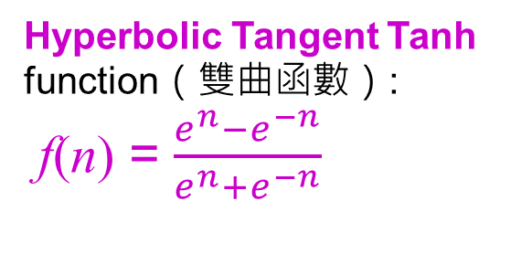
Activation Functions (3/3)
The activation function f may be a linear or nonlinear function of n
Hyperbolic Tangent Tanh function（雙曲函數）:
f(n) = $\frac{e^{n}−e^{−n}}{e^{n}+e^{−n}}$
Rectified Linear Unit（ReLU） function（線性整流函數）:
f(n) = max(0, n)
Leaky ReLU function:
f(n) = max(0.01n, n)
實務上，負的有跟沒有差不多，所以比較prefer Rectified Linear Unit ReLU
-> 變形的線性函數
訊號很強 就希望它的輸出也很強
如果訊號很弱 甚至是負的 就當作它們不重要
是Logistic sigmoid function 的變形
Ex: 把同學的分數壓縮在1和-1之間

Slide 18
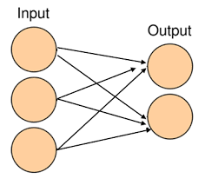
Network Architectures (1/3)
A Layer of Neurons
Ex:這個神經元做pass or fail
Ex:這個神經元做數值

Slide 19
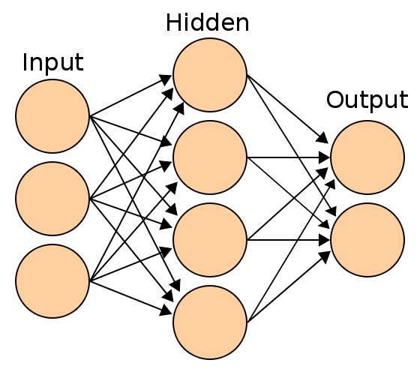
Network Architectures (2/3)
Multiple Layers of Neurons

Slide 20
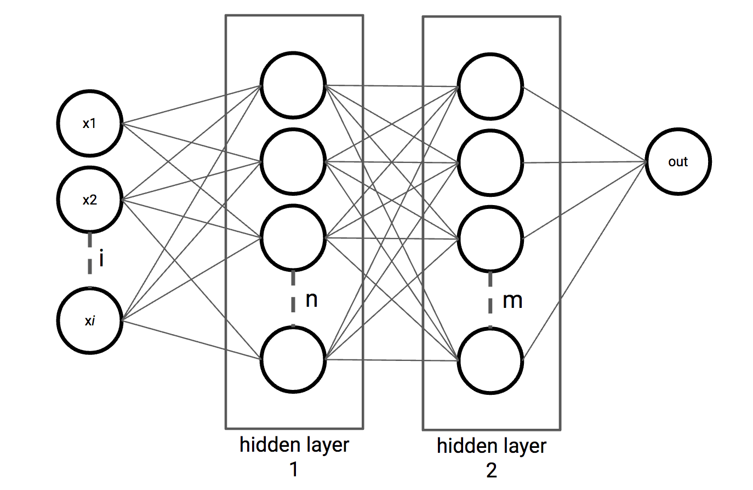
Network Architectures (3/3)
Multiple Layers of Neurons
The layer that receives inputs is called the input layer.
The outputs of the network are generated from the output layer.
Any layer between the input and the output layers is called a hidden layer.
-> 如果問題很簡單 不需要隱藏層
輸入層和輸出層永遠只有一個 但是隱藏層可以有很多個
Ex: 如果有兩個隱藏層 一個輸出層 我們稱它為三層的神經元
因為真正有神經元的是隱藏層一 隱藏層二和輸出層 ( 但也有人說它是四層 ex:有人說 tree 的 root 是在 level 1也有人說在level 0 )

Slide 21
Representational Power of Feedforward（前饋）Networks
Boolean functions
Every boolean function can be represented exactly by some network with two layers ( i.e., one single hidden layer) of units
But might require exponential (in number of inputs) hidden units
Continuous functions
Every bounded continuous function can be approximated with arbitrarily small error by a network with two layers
Arbitrary functions
Any function can be approximated to arbitrary accuracy by a network with three layers ( i.e., two hidden layers)
Note: Although a limited depth of feedforward networks can provide a very expressive hypothesis space for Backpropagation, the number of neurons in a hidden layer can be exponential in the input dimension.

Slide 22
Summary
An Artificial Neural Network (ANN) is a computational model inspired by biological network systems.
A biological neuron:
Dendrites, a cell body, and an axon.
Synapse is between the axon of one neuron with the dendrite of another neuron.
An artificial neuron:
A set of input nodes, a set of weights, an activation function that relates the total synaptic input to the output (activation) of the neuron.
Activation function
Define the output of a neuron
The essential elements of an artificial network are an input layer, an output layer, and may contain hidden layers.

Slide 23
References
[1] Networks are like onions: Practical Deep Learning with TensorFlow, Barbara Fusinska, London Tensorflow Meetup, Jun 21, 2017.
[2] Neural Network Design (2nd Edition), Martin T Hagan , Howard B Demuth , Mark H Beale , and Orlando De Jesús, Martin Hagan, 2014.
[3] Pattern Recognition and Machine Learning, Christopher Bishop, Springer-Verlag New York, 2006.
[4] Machine Learning, Tom M. Mitchell, McGraw-Hill, 1997.

